Slide 1

Path integrals and sparse representations in computational stochastic dynamics
Apostolos Psaros, PhD
Postdoctoral Research Scientist
Stochastic Engineering Dynamics Lab
Department of Civil Engineering & Engineering Mechanics
Columbia University
Notes:
Good afternoon and thanks a lot for the invitation. My name is Apostolos Psaros, I am a postdoc researcher at Columbia University and I work in the area of computational stochastic dynamics under the supervision of Professor Kougioumtzoglou. Today, I will be presenting our work on path integrals for stochastic analysis of complex dynamical systems, of interest to engineering mechanics.

Slide 2
PRESENTATION OUTLINE
Motivation
Stochasticity and complex system modeling
Path integration
Ito SDE
Integration over all possible paths
Variational problem
Extensions, generalizations and enhancements
Versatility
Accuracy
Computational efficiency
Concluding remarks & ongoing/future research
Notes:
My presentation will go as follows: First, I will very briefly describe the motivation behind our work, and then I will introduce the concept of path integration and explain how it can be applied to engineering systems of interest. Further, I will present our recent developments in terms of the versatility, the accuracy and the computational efficiency of the technique and conclude with ongoing and future work.

Slide 3
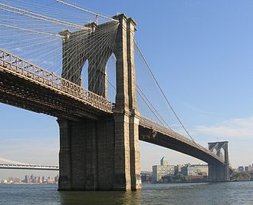
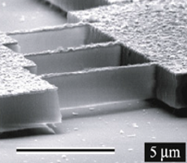


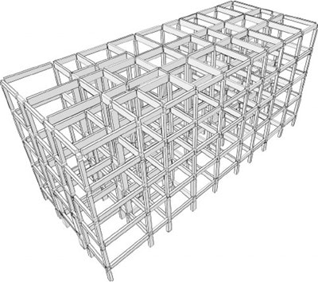
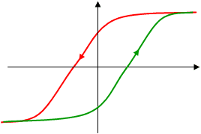
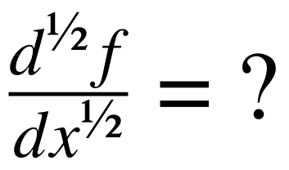
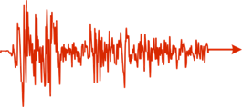
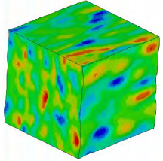
MOTIVATION: Stochasticity and complex system modeling
Diverse engineering mechanics & dynamics systems
Nanomechanical systems
(e.g., nano-resonators)
Vibratory energy harvesters
(e.g., piezoelectric devices)
Civil infrastructure systems
(e.g., bridges, maritime structures)
Common challenges in analysis & design
High dimensionality
Complex modeling
Stochasticity
Notes:
Irrespective of the scale of the problem, either it pertains to a nanomechanical oscillator, or a mechanical device or an infrastructure system, common challenges in analysis and design pertain to high-dimensionality, complex mathematical modeling (such as fractional derivative modeling) and stochasticity in the input and the system parameters.

Slide 4
MOTIVATION: Stochasticity and complex system modeling
Diverse engineering mechanics & dynamics systems
Nanomechanical systems
Objective:
Uncertainty propagation
Vibratory energy harvesters
Analysis
Optimization
Design
Determining mean & variance is NOT enough
Probability density function (PDF)
Civil infrastructure systems
PDF
Low-probability
events
Response quantity
PATH INTEGRAL: Joint response PDF
Notes:
In this context, the objective of uncertainty propagation is to analyze, design and optimize complex systems under the presence of uncertainty. However, obtaining only the first moments of the stochastic response may not be adequate and a complete stochastic characterization is required instead – see for instance cases where design on low probability events is required. To this aim, the path integral technique I will be presenting today attempts to accurately obtain the joint non-stationary PDF of the response.

Slide 5
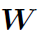
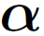
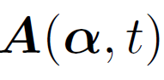
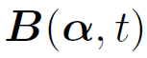
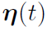
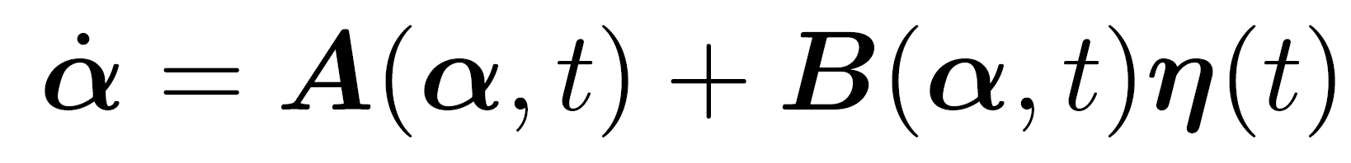
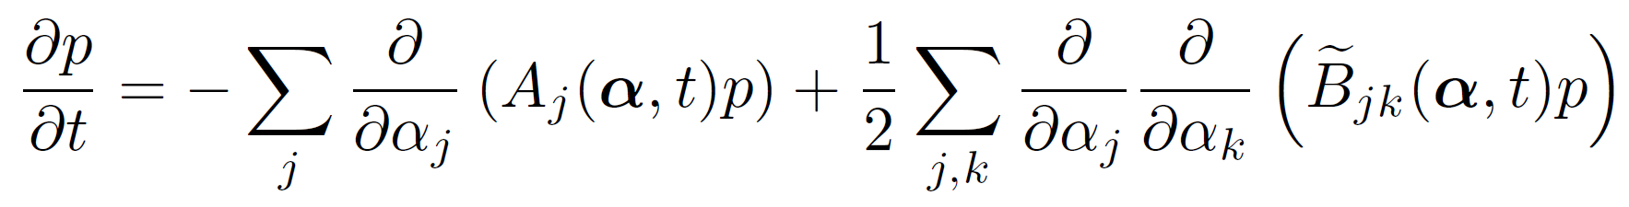
THE WIENER PATH INTEGRAL TECHNIQUE: Formulation
Wiener path integral formalism
Wiener process:
Response:
Drift vector:
Diffusion vector:
White noise:
Ito
SDE
Langevin
form
Fokker-Planck
Notes:
Let’s start with the problem at hand and the path integral formalism. Consider a typical form of an Ito SDE where W represents a Wiener process, A the drift vector, that is the deterministic part of the forcing and B the diffusion matrix, that is how the stochastic force is distributed across the various degrees of freedom. This equation is equivalently written in a Langevin form that we may be more familiar with, where eta represents Gaussian white noise, and the Fokker Planck equation that describes how the density function of the response evolves in time. Fokker Planck is therefore a deterministic equation that describes not the stochastic process itself but its PDF.
***** Loosely speaking the white noise process can be seen as the derivative of Wiener process but this is somewhat misleading because Wiener process paths are nowhere differentiable. In any case, we could treat it as symbolic expressions here knowing that the connections of all these equations can be well defined using stochastic integrals. And of course, that’s important to know.

Slide 6
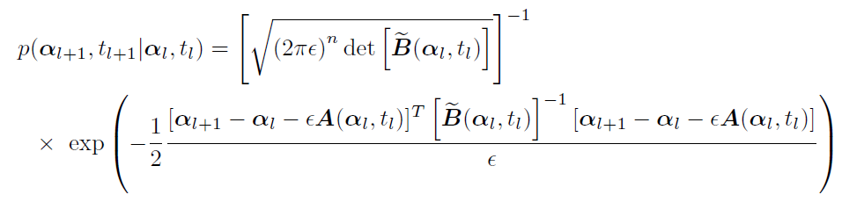
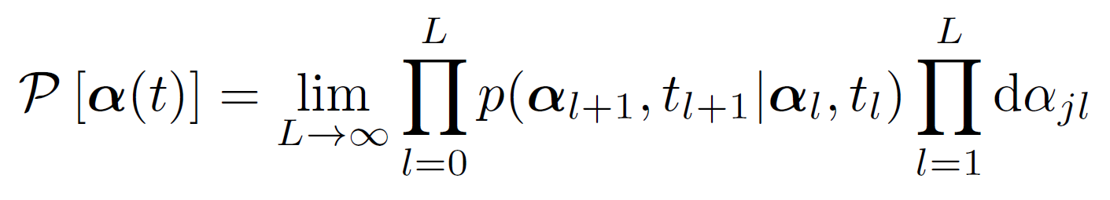
THE WIENER PATH INTEGRAL TECHNIQUE: Formulation
Wiener path integral formalism
Satisfies Fokker-Planck equation
Path probability as a compound event
Short-time
propagator
Small time increments
Path
probability
Notes:
In this regard, it can be shown that a short-time transition density function that takes a Gaussian form is compatible with the Fokker-Planck and the SDE. This is called a short time propagator because it shows how the PDF propagates for very small time increments. By using this fact, the probability of the stochastic process following a specific path can be given as a compound event (that is a product of short-time probabilities), where the Markovianity of the process has been used.

Slide 7
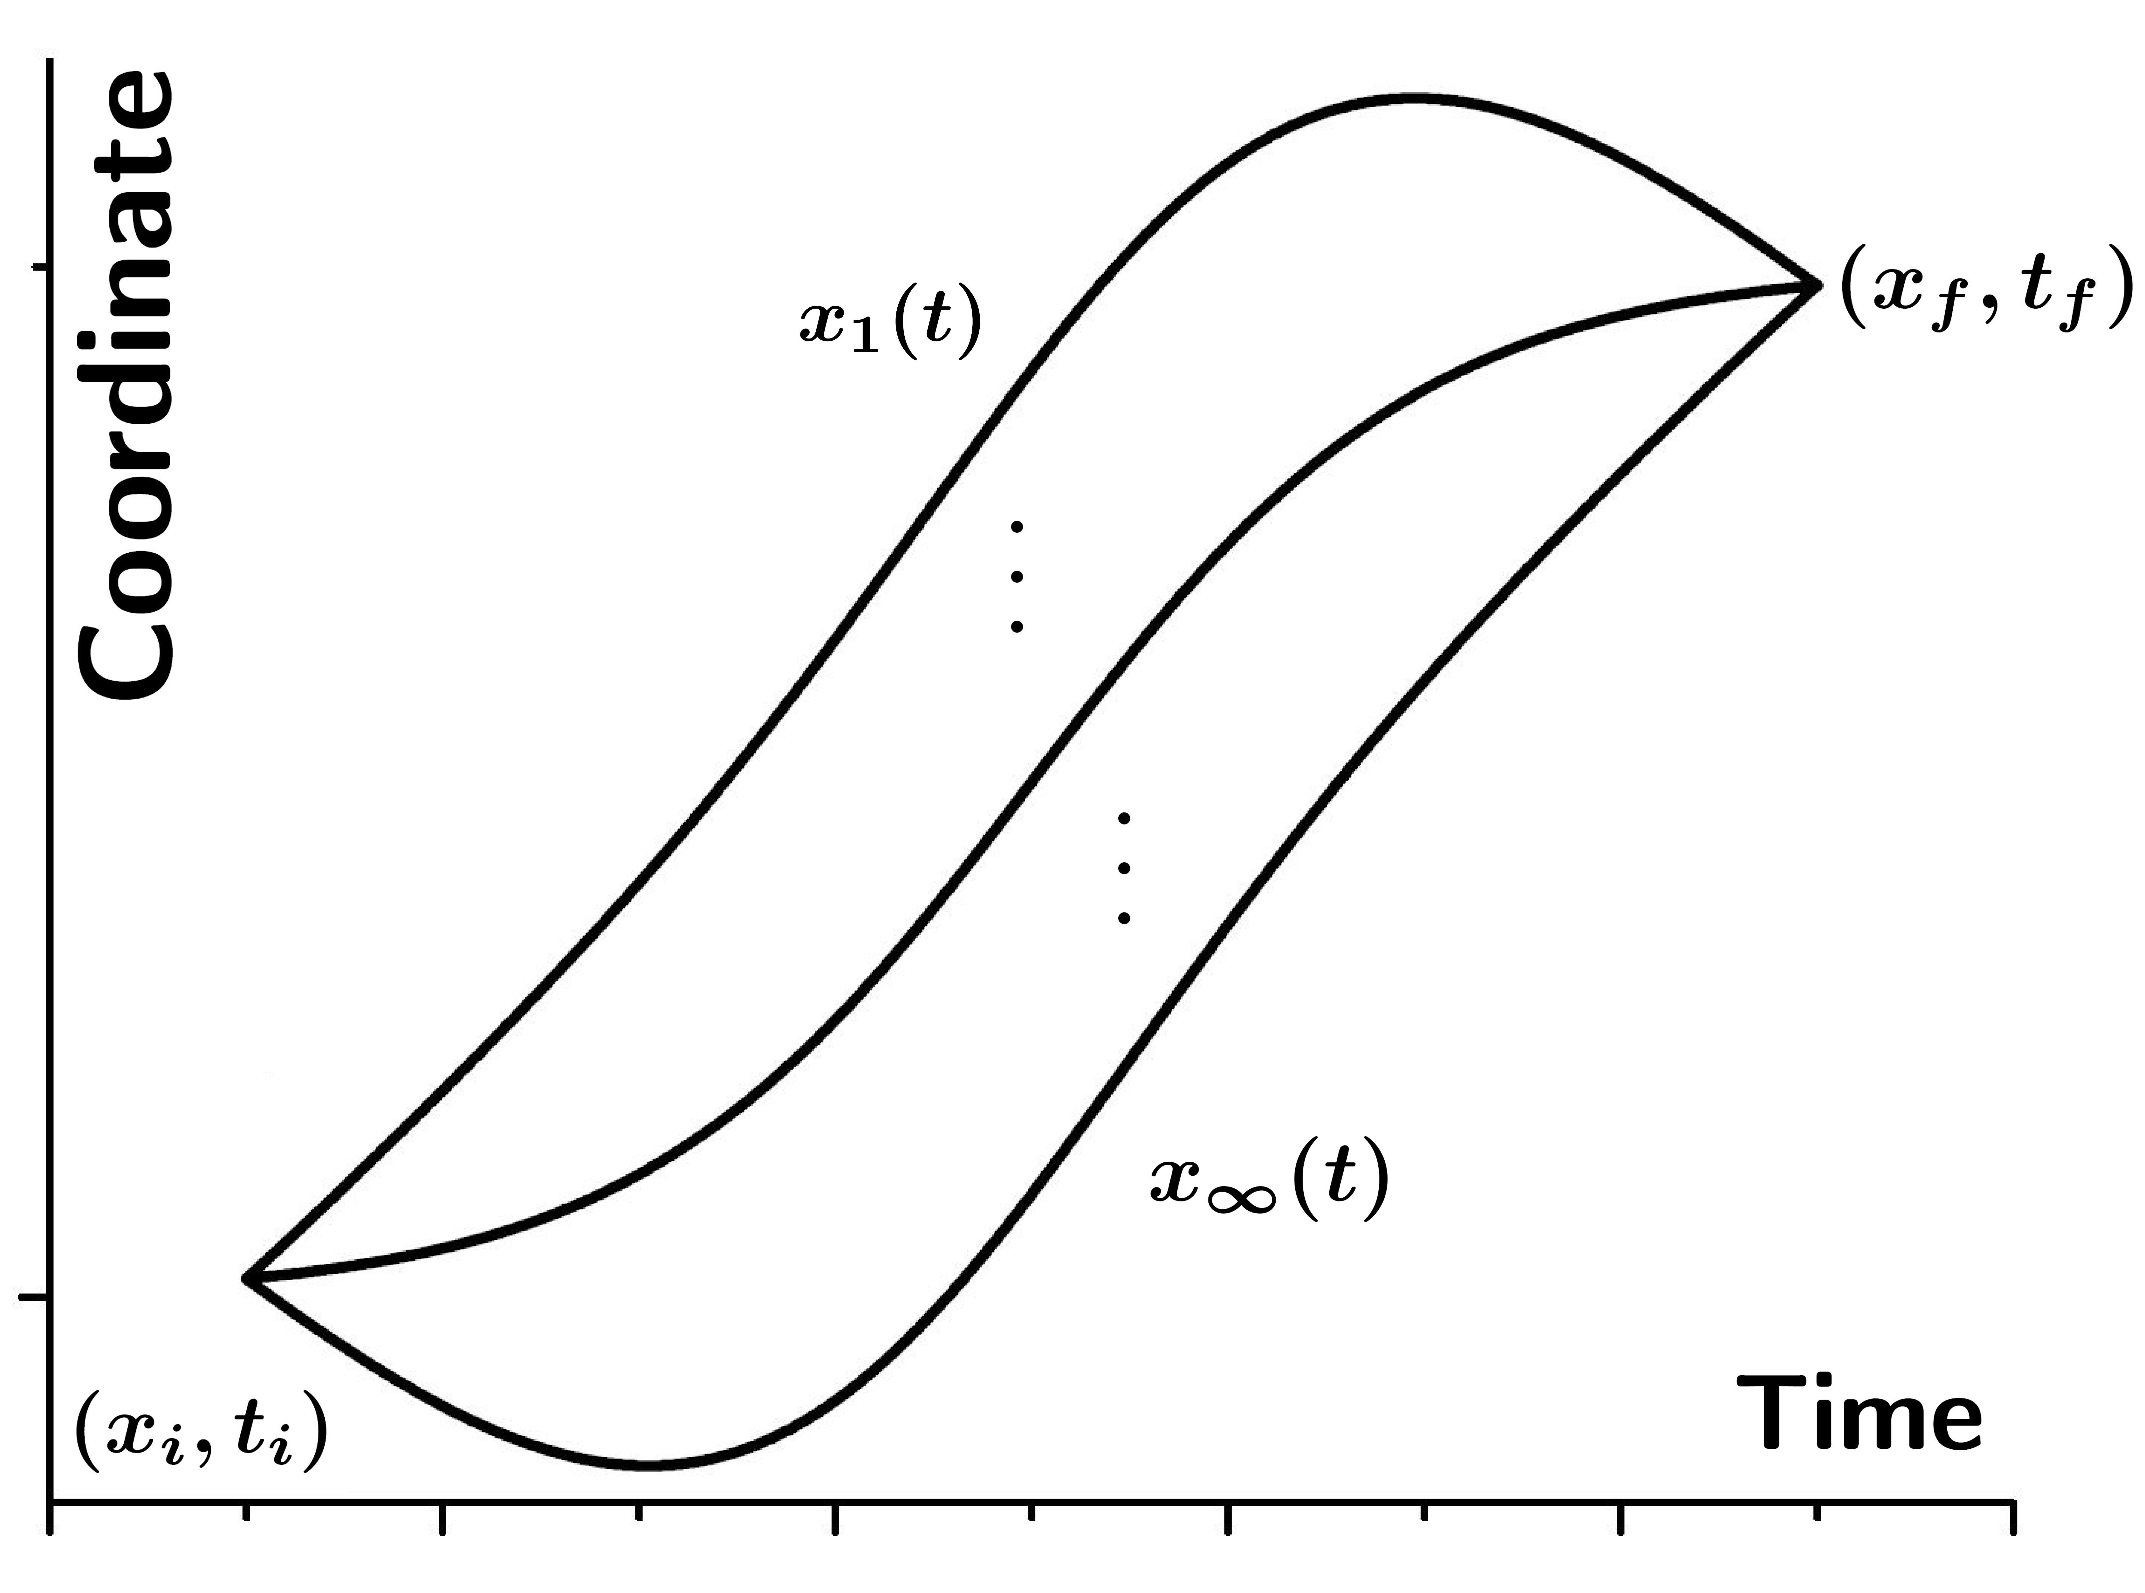
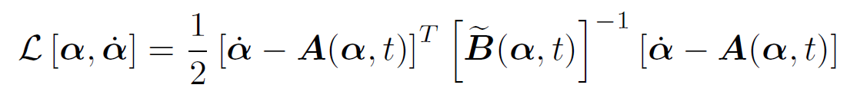
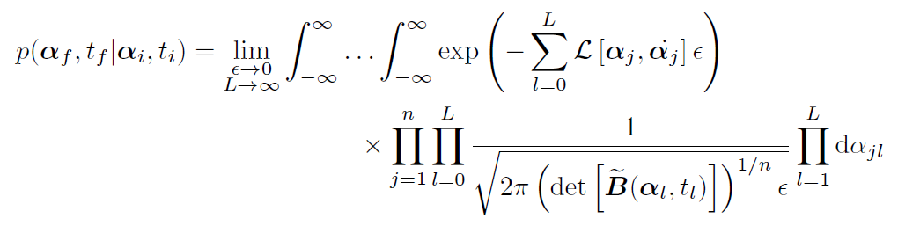
THE WIENER PATH INTEGRAL TECHNIQUE: Formulation
Wiener path integral formalism
f
i
Path
integral
Notes:
Next, by denoting with L the expression in the exponential, the probability of the response process to start from some initial point and end up at a final point can be given as a multidimensional integral over all the possible intermediate points that the process may pass from.

Slide 8
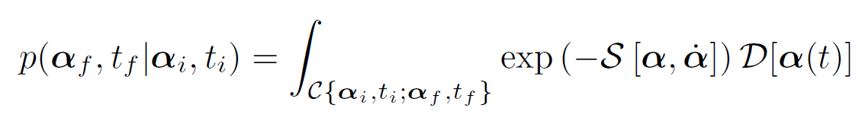
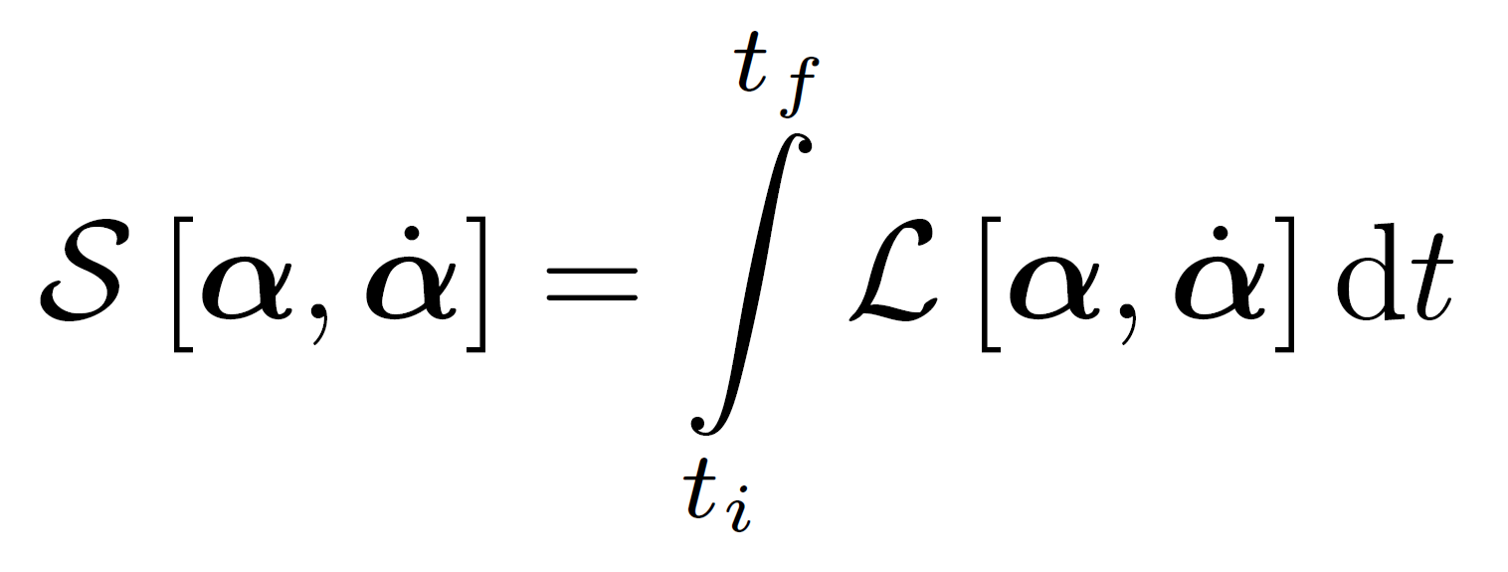
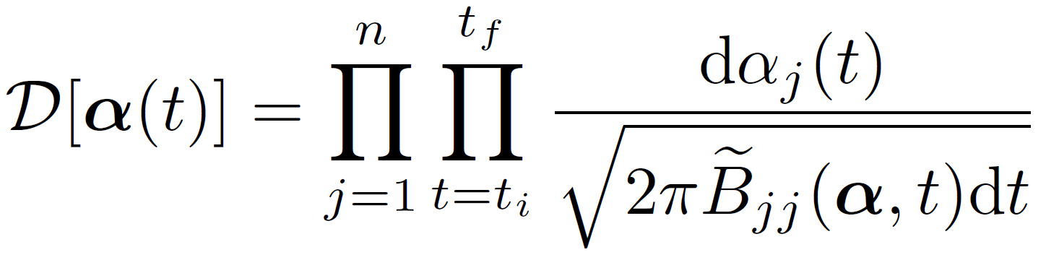
THE WIENER PATH INTEGRAL TECHNIQUE: Formulation
Wiener path integral formalism
f
i
Path
integral
Wiener (1921), Proc Natl Acad Sci
Feynman (1948), Rev Mod Phys
Notes:
In the continuous limit, this can be construed as an integral over all the possible paths that the process may take in order to start from the given initial point and end up at the given final point. I will be calling these points initial and final conditions and note that all the paths have to satisfy these conditions. Certainly, each path has a different probability of occurrence, which in the continuous limit takes the form of a probability density functional and is the integrand of this functional integral.
In terms of notation, L is called stochastic Lagrangian, S, which is the integral of the Lagrangian, is the stochastic action, and D is the functional measure of integration.
As a side note, I would like to mention that such path integrals have been first used by Wiener for addressing problems with stochastic processes and by Feynman in theoretical physics for treating quantum mechanics problems.

Slide 9
THE WIENER PATH INTEGRAL TECHNIQUE: Formulation
Wiener path integral formalism
Analytical solutions
Simulations
f
Path integral
i
Notes:
Even though this expression is exact, the transition probability can be obtained analytically only for very simple systems. Alternatively, one could follow a Monte Carlo based approach and obtain samples from the probability density functional and sum over those samples. However, this approach comes with high computational cost.

Slide 10
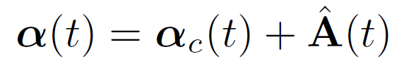
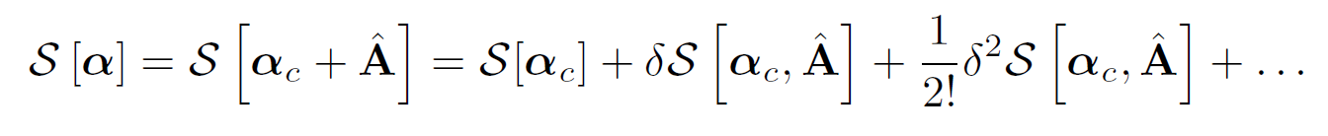
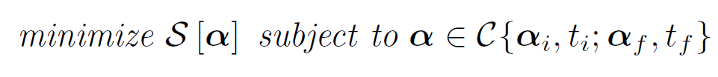
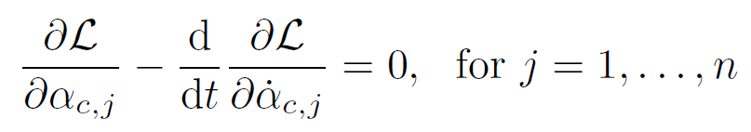
THE WIENER PATH INTEGRAL TECHNIQUE: Formulation
Wiener path integral formalism
Analytical solutions
Simulations
Variational problem
f
Path integral
i
0
C
Euler-Lagrange equations:
Deterministic!
Notes:
Another approach is the variational one; that is, to expand the stochastic action S in a Taylor-like fashion around the path for which the first variation vanishes. This path is associated with an extremum of the stochastic action functional and it represents the path with the maximum probability of occurrence. We’ll be calling it the most probable path and in order to determine it a variational problem is solved for the minimum stochastic action. Of course this variational problem is equivalent with the corresponding Euler Lagrange equations.
Therefore, it is readily realized that an approximate way to solve the problem is to treat all the higher order variations in the series expansion as constant and approximate the PDF as a product of a normalization constant and an exponential part that resembles the probability of the most probable path.
As a result, following this most probable path approximation, the original stochastic problem is transformed into a deterministic problem. How accurate is this? We’ll try to answer this question later in the presentation. Note, that unless the EL equations can be solved for all final conditions in closed form, the solution of the variational problem has to be obtained for each and every final condition and for every time instant of interest separately.
As a result, for each final condition, either the two-point BVP defined by the EL equations is solved,
or equivalently the variational problem is solved with, for example, a Rayleigh Ritz approach.

Slide 11
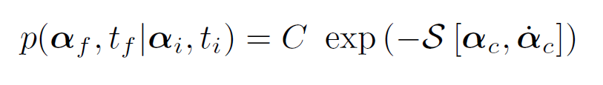
THE WIENER PATH INTEGRAL TECHNIQUE: Formulation
Wiener path integral formalism
Analytical solutions
Simulations
Variational problem
f
Path integral
i
Most probable path approximation
Notes:
After the most probable path is obtained, it is substituted in the stochastic action for obtaining the response PDF and the constant C in front of the exponential that depends only on time is obtained in the end by normalizing the PDF.

Slide 12
THE WIENER PATH INTEGRAL TECHNIQUE
Extensions, generalizations and enhancements
Versatility
MDOF nonlinear oscillators subject to non-white and non-Gaussian excitations
Accuracy
Most probable path accuracy and accounting for fluctuations
Computational efficiency
Linear and nonlinear approximations for reducing the computational cost
Notes:
I will now go through some recent developments that pertain to engineering stochastic dynamics problems.

Slide 13
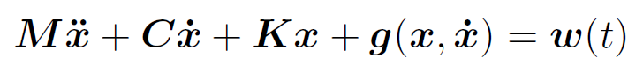
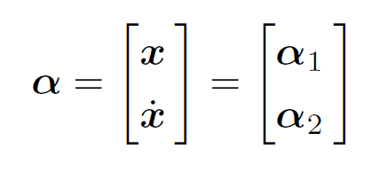
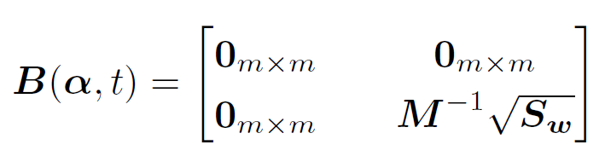
THE WIENER PATH INTEGRAL TECHNIQUE: Versatility
Dynamical systems subject to white noise
f
Psaros et al. (2018), J Sound & Vibration
i
Augmented Markov process
Singular
diffusion
Notes:
For second order SDEs that typically describe stochastic dynamical systems, the situation is a bit more involved than before. Specifically, for a system subject to Gaussian white noise, the governing equation is written as a first order system and this, leads to solving for the augmented set of variables x and xdot, which together define a Markov process. However, only one equation has stochastic force and the other is merely a compatibility equation. In the Ito SDE formulation, this translates as a singular diffusion matrix, which cannot be readily utilized in the path integration formulation that requires an invertible diffusion matrix.

Slide 14
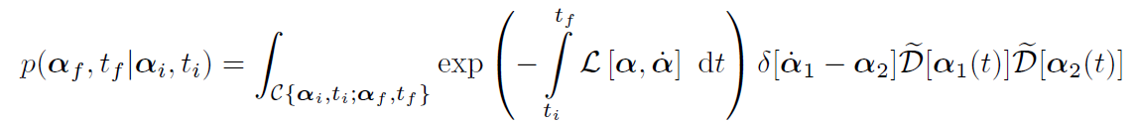
THE WIENER PATH INTEGRAL TECHNIQUE: Versatility
Dynamical systems subject to white noise
f
Psaros et al. (2018), J Sound & Vibration
i
Singular part
Non-singular part
Notes:
In this case, the singularity can be overcome by analytical manipulations using delta functionals that account for the compatibility conditions and, by defining a stochastic Lagrangian with two parts, one that corresponds to the singular part of the diffusion and one that corresponds to the non-singular part.

Slide 15
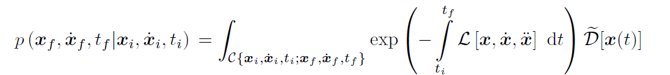
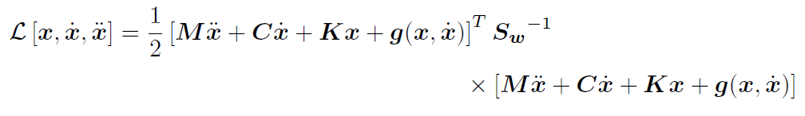
THE WIENER PATH INTEGRAL TECHNIQUE: Versatility
Dynamical systems subject to white noise
f
Psaros et al. (2018), J Sound & Vibration
i
Path integral
Notes:
Next, integrating over all velocity variables yields a new path integral, with the final stochastic Lagrangian defined only by the non-singular part of the diffusion matrix and with a modified functional measure.

Slide 16
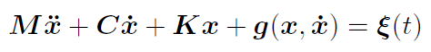
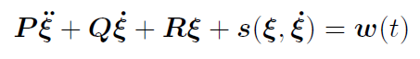
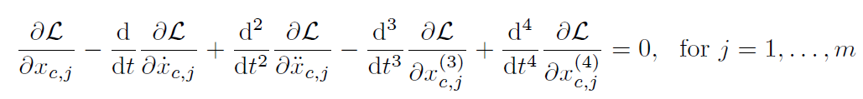
THE WIENER PATH INTEGRAL TECHNIQUE: Versatility
Dynamical systems subject to non-white & non-Gaussian noise
4th order SDE
Euler-Lagrange equations
f
Psaros et al. (2018), J Sound & Vibration
original
filter
i
Notes:
In a similar fashion, we can treat oscillators subject to non-white and non-Gaussian excitations by assuming that the excitation can be approximated by a nonlinear filter equation with Gaussian white noise on the right-hand side. In this regard, note that it is straightforward to obtain a filter approximation describing the excitation even when only the power spectrum of the excitation is available. Having obtained a filter approximation, the set of filter and governing equations is written as a higher order SDE with white noise on the right hand side and is solved with the path integral technique as before by integrating over all the compatibility variables. Note that for the resulting higher order SDE, the number of stochastic variables increases. For example, for an m-degree of freedom system we have to account for 4m stochastic variables. Similarly the order of the EL equations increases as well.

Slide 17
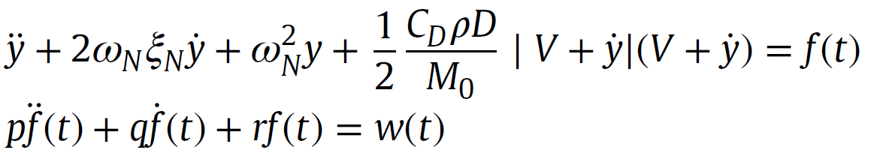
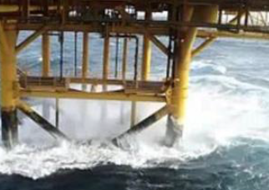
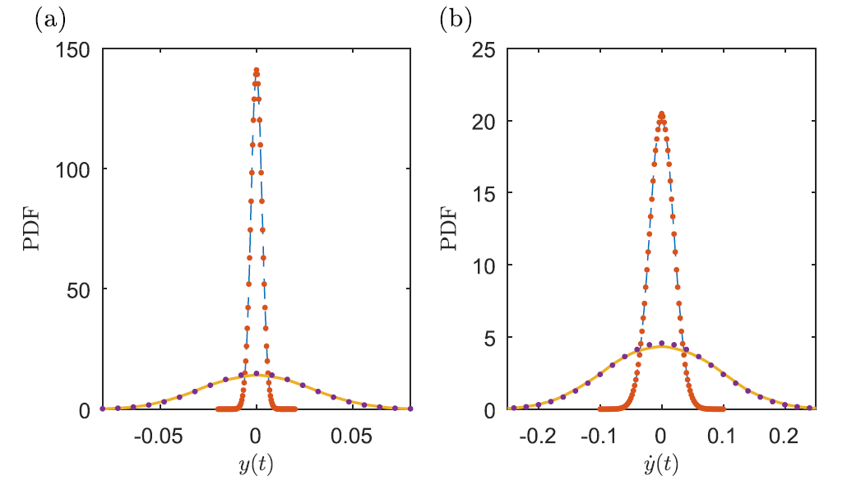
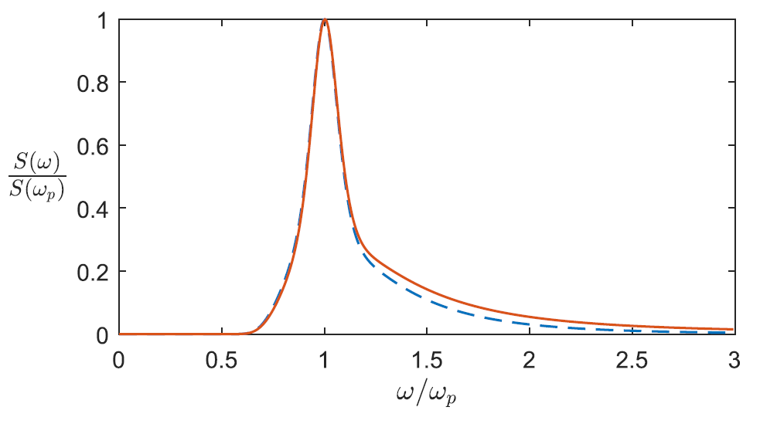
THE WIENER PATH INTEGRAL TECHNIQUE: Versatility
Dynamical systems subject to non-white & non-Gaussian noise
f
Psaros et al. (2018), J Sound & Vibration
original
Example
Offshore structure subject to sea-waves forces
filter
i
Path integral
Power spectrum
MCS
Notes:
Indicatively, we have used the path integral technique to solve a marine engineering problem describing an off-shore structure subject to random forces induced by sea waves. The typically utilized Jonswap power spectrum is considered and the excitation is approximated by a second-order filter that is combined with the governing stochastic equation.
By solving the resulting system with the path integral technique we obtain results for the nonstationary response PDF with satisfactory accuracy as compared to a benchmark solution such as Monte Carlo simulation.
*** For example the results I’m showing here have an average normalized l2 error of about 1% as compared to monte carlo, but the questions is how many realizations should we compare with? So in general I didn’t talk about such comparisons on purpose because it’s a separate project to formally compare our results with monte carlo simulation. And I wanted the main takeaway of the presentation to be that we have small quantifiable errors compared to monte carlo and we know how to improve them by quadratic approximations. I showed however a plot of monte carlo based error for the most probable path and the quadratic approximation.

Slide 18
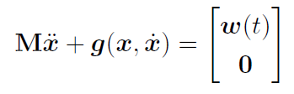
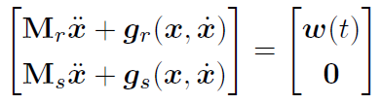
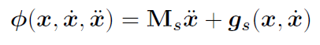
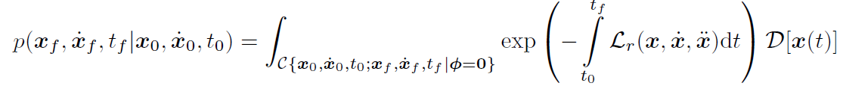
THE WIENER PATH INTEGRAL TECHNIQUE: Versatility
Dynamical systems with singular diffusion matrices
f
Petromichelakis, Psaros, Kougioumtzoglou (2020), PREM
e.g., only some DOFs forced
i
Set of paths satisfying the conditions
Notes:
Nevertheless, there are cases in which the auxiliary deterministic equations are not just compatibility equations. Such cases pertain indicatively to dynamical systems with only some DOFs forced, hysteretic models with nonlinear auxiliary differential equations, and energy harvesting systems. In such cases, an analytical manipulation as before by just increasing the dimension of the problem and integrating over the time derivatives of the response is not possible. To address this issue, the stochastic equations can be divided into an underdetermined system of SDEs, that corresponds to the non-singular part of the diffusion matrix, and a set of homogeneous equations that corresponds to the singular part. By doing so, the path integral can be defined using only the non-singular part and the singular part enters the variational problem as a set of constraint equations.

Slide 19
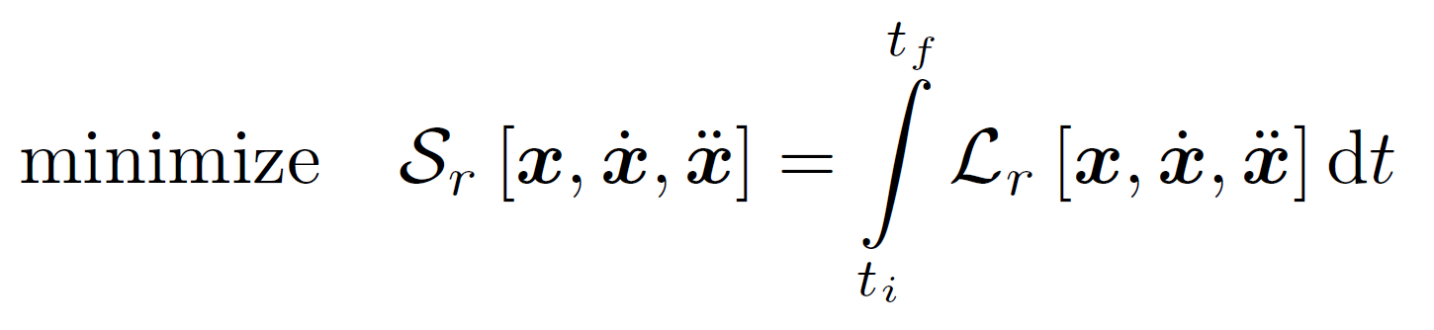
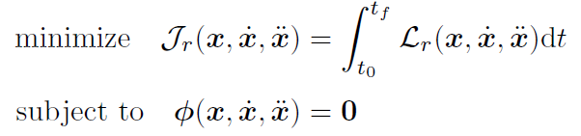
THE WIENER PATH INTEGRAL TECHNIQUE: Versatility
Dynamical systems with singular diffusion matrices
f
Petromichelakis, Psaros, Kougioumtzoglou (2020), PREM
e.g., only some DOFs forced
i
Constrained
variational problem
Solutions:
Euler-Lagrange eqs
Rayleigh-Ritz
Notes:
We obtain therefore a constrained variational problem.
For solving the constrained variational problem, we can either use the Lagrange multipliers approach that yields a modified stochastic Lagrangian and thus a modified set of EL equations or, use a Rayleigh Ritz approach. Specifically, the Rayleigh Ritz approach leads to a constrained optimization problem for the expansion coefficients that is solved with appropriate algorithms such as Sequential Quadratic Programming approaches, the Augmented Lagrangian method or another technique for handling such problems.

Slide 20
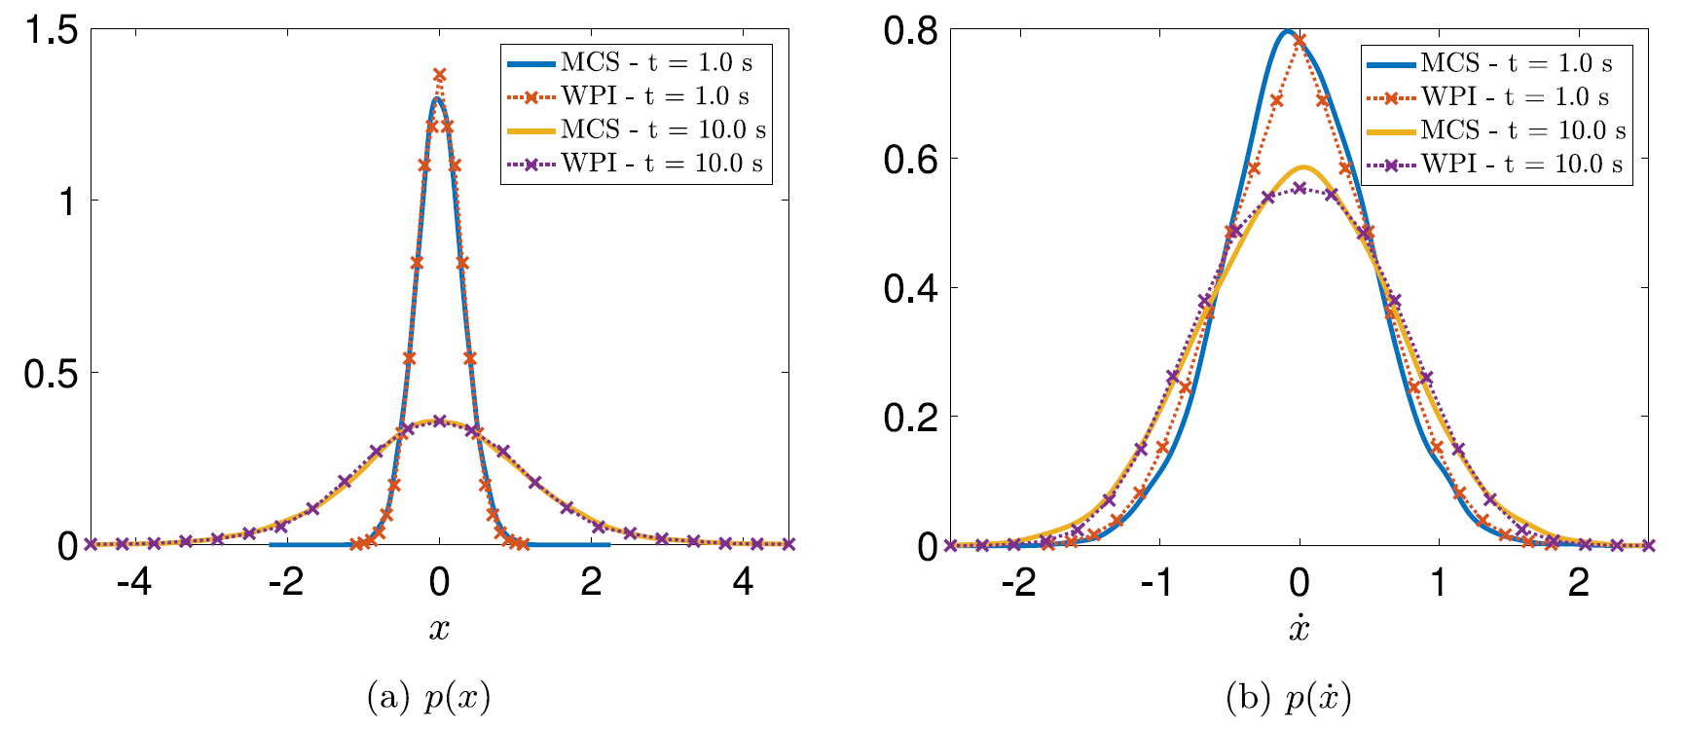
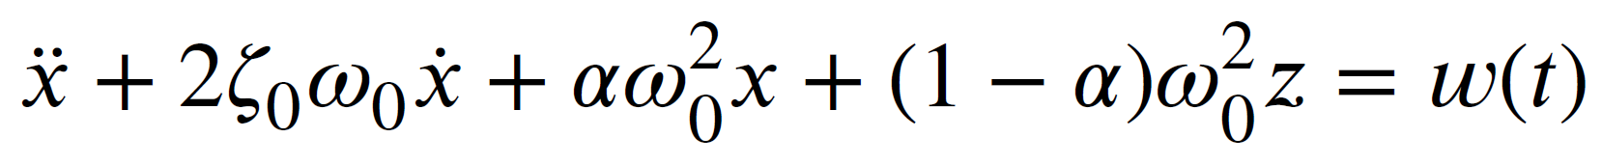
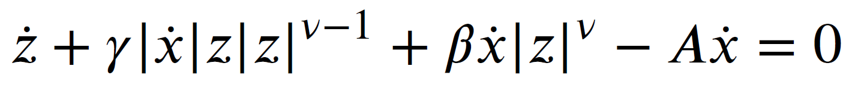
THE WIENER PATH INTEGRAL TECHNIQUE: Versatility
Dynamical systems with singular diffusion matrices
f
Petromichelakis, Psaros, Kougioumtzoglou (2020), PREM
Example
SDOF Bouc–Wen oscillator
i
Path integral
MCS
Notes:
For example, we have used the technique to address a Bouc-Wen SDOF nonlinear oscillator that is typically used for modeling systems with hysteresis. The governing dynamics equation is a system of 2 equations where the top part is used to define the stochastic Lagrangian while the bottom part is used as a constraint. The problem is solved using the Rayleigh Ritz approach with Hermite and Legendre polynomials and a quasi-Newton approach for solving the constrained optimization problem. The results compare well with those of Monte Carlo simulation, but are obtained with much less computational effort.

Slide 21
THE WIENER PATH INTEGRAL TECHNIQUE
Extensions, generalizations and enhancements
Versatility
MDOF nonlinear oscillators subject to non-white and non-Gaussian excitations
Accuracy
Most probable path accuracy and accounting for fluctuations
Computational efficiency
Linear and nonlinear approximations for reducing the computational cost
Notes:
Next, I would like to discuss about the accuracy of the technique.

Slide 22
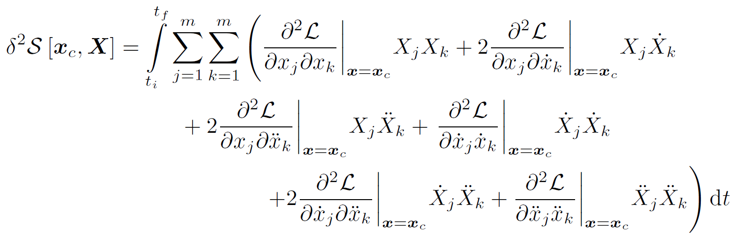

THE WIENER PATH INTEGRAL TECHNIQUE: Accuracy
0
Linear systems
Constant
Most probable path approximation
Exact!
Closed form solutions: Psaros, Zhao, Kougioumtzoglou (2020), PREM
Notes:
First, focusing on linear systems, note that in the expansion of the stochastic action described before, the second order variation becomes constant and the higher order variations vanish. For this reason, the most probable path approximation discussed previously gives the exact solution of the problem. In this regard, considering also the mathematical merit of exact closed form solutions, in a recent paper we showed how by solving the EL equations analytically we can obtain an exact closed form solution for the nonstationary response PDF. Specifically, by substituting the solution for the most probable path and its derivatives in the stochastic action and by manipulating analytically the expressions, we were able to obtain closed form solutions that we compared with others found in the literature and obtained using different techniques.

Slide 23





THE WIENER PATH INTEGRAL TECHNIQUE: Accuracy
0
Nonlinear systems
Most probable path approximation
Example
Electromechanical energy harvester
Approximate
Response analysis & optimization of harvesters:
Petromichelakis, Psaros, Kougioumtzoglou (2018), PREM
Notes:
Returning now to nonlinear systems, in many cases the most probable path approach exhibits high accuracy as compared with Monte Carlo simulation results. For example, we have considered the problem of electromechanical energy harvesters that are described by the shown set of equations and we compared the results with a statistical linearization approach. The path integral results are comparable in accuracy with Monte Carlo simulation results and are much more accurate than the statistical linearization results.
*** For example the results I’m showing here have an average normalized l2 error of about 1% as compared to monte carlo, but the questions is how many realizations should we compare with? So in general I didn’t talk about such comparisons on purpose because it’s a separate project to formally compare our results with monte carlo simulation. And I wanted the main takeaway of the presentation to be that we have small quantifiable errors compared to monte carlo and we know how to improve them by quadratic approximations. I showed however a plot of monte carlo based error for the most probable path and the quadratic approximation.

Slide 24

THE WIENER PATH INTEGRAL TECHNIQUE: Accuracy
0
Accuracy enhancement
Psaros, Kougioumtzoglou (2020), JEM
x_{i}
x_{f}
t_{i}
t_{f}
Most probable path
“Brownian bridge”
Notes:
However, depending on the magnitude of nonlinearity and on the time at which the PDF is computed, the accuracy of the most probable path approximation may not be acceptable. It is after all a zero order approximation. To enhance the accuracy of the technique, we have shown recently how we can consider not only the most probable path but also fluctuations around it. Note, that in the functional series expansion we have expressed the response x as the sum of the most probable path xc and a fluctuation term upper case X, which is known also as Brownian bridge when the process x is a Brownian motion because this fluctuation process vanishes at the boundaries. Therefore, within this context, accounting for fluctuations amounts to considering also additional terms in the expansion.

Slide 25

THE WIENER PATH INTEGRAL TECHNIQUE: Accuracy
0
Accuracy enhancement
Psaros, Kougioumtzoglou (2020), JEM
Zero initial/final conditions
Quadratic approximation
Fluctuation factor
Notes:
For example, if the second order variation is considered as well, we obtain a quadratic approximation of the path integral, where phi is a factor accounting for fluctuations and the exponential part is exactly the same as before. Note that this factor is now unique for each final condition, and it’s not a shared normalization constant anymore. Further, the fluctuation factor is itself given as a path integral but because the Brownian bridge X vanishes at the boundaries, this path integral can be approximated with high accuracy.

Slide 26

THE WIENER PATH INTEGRAL TECHNIQUE: Accuracy
0
Accuracy enhancement
Psaros, Kougioumtzoglou (2020), JEM
Zero initial/final conditions
Fluctuation factor
Notes:
Specifically, by utilizing an infinite discrete expression of this new path integral we obtain a multi-dimensional Gaussian integral, because the exponent in the integrand is a quadratic form, which has an analytical solution for finite numbers of integrations.

Slide 27

THE WIENER PATH INTEGRAL TECHNIQUE: Accuracy
0
Accuracy enhancement
Psaros, Kougioumtzoglou (2020), JEM
Zero initial/final conditions
Fluctuation factor
Determinant of pentadiagonal matrix
Notes:
Therefore, the computation of the fluctuation factor becomes a problem of computing the determinant of a large pentadiagonal matrix. Finally, the fact that this factor can be obtained directly without normalization, opens up the possibility of using the technique for reliability assessment applications.

Slide 28


THE WIENER PATH INTEGRAL TECHNIQUE: Accuracy
0
Accuracy enhancement
Psaros, Kougioumtzoglou (2020), JEM
Zero initial/final conditions
Fluctuation factor
Example
SDOF nonlinear oscillator
Gaussian white noise
Asymmetric nonlinearity
Significant enhancement!
Notes:
For example, considering an oscillator with asymmetric x squared nonlinearity, we obtain results much more accurate than by using the most probable path approach and we can also estimate low-probability events efficiently. In the left figure you can see the Monte Carlo based error of the standard technique and its extension (we see that the enhancement is quite significant especially for large time instants) and on the right hand side the evolution of the fluctuation factor in time. As you can see, the fluctuation factor changes considerably not inly in time but for different x and x dot values for a given time!
*** For example the results I’m showing here have an average normalized l2 error of about 1% as compared to monte carlo, but the questions is how many realizations should we compare with? So in general I didn’t talk about such comparisons on purpose because it’s a separate project to formally compare our results with monte carlo simulation. And I wanted the main takeaway of the presentation to be that we have small quantifiable errors compared to monte carlo and we know how to improve them by quadratic approximations. I showed however a plot of monte carlo based error for the most probable path and the quadratic approximation.

Slide 29
THE WIENER PATH INTEGRAL TECHNIQUE
Extensions, generalizations and enhancements
Versatility
MDOF nonlinear oscillators subject to non-white and non-Gaussian excitations
Accuracy
Most probable path accuracy and accounting for fluctuations
Computational efficiency
Linear and nonlinear approximations for reducing the computational cost
Notes:
The last topic I would like to talk about pertains to the computational efficiency of the technique.

Slide 30

THE WIENER PATH INTEGRAL TECHNIQUE: Efficiency
One deterministic optimization problem
Single point of the PDF at a given time
Numerical implementation: Set of deterministic problems
Brute-force implementation
Notes:
As we discussed earlier, the variational problem cannot be solved for all final conditions directly in closed form and therefore multiple solutions are required for obtaining multiple points of the response PDF.

Slide 31

THE WIENER PATH INTEGRAL TECHNIQUE: Efficiency
One deterministic optimization problem
Single point of the PDF at a given time
Response PDF approximation
Adopt expansion basis
Kronecker product bases
Positive definite functions
Sample at random points in the domain
Numerical implementation: Set of deterministic problems
Brute-force implementation
N_{s}^{2m}
Notes:
In this regard, by discretizing an effective domain of the PDF we are left with a number of variational problems to solve that easily gets out of hand. For this reason, a data fitting procedure is followed. Specifically, the PDF is written as a linear combination of basis functions and is approximated by obtaining only a small number of measurements. To be more precise, these measurements are in essence sampled PDF values using the path integral technique. In terms of indicative bases, we have used Kronecker product bases that have been successfully used in the literature for video processing and other applications and provide a high dimensional basis by combining lower dimensional bases. Also, we have used positive definite functions such as anisotropic Gaussian functions. By doing so, we gather measurements using the path integral technique in the spatiotemporal domain and approximate the multidimensional curve by solving a linear system.

Slide 32
THE WIENER PATH INTEGRAL TECHNIQUE: Efficiency
One deterministic optimization problem
Single point of the PDF at a given time
Response PDF approximation
Adopt expansion basis
Kronecker product bases
Positive definite functions
Sample at random points in the domain
Numerical implementation: Set of deterministic problems
Example
2-DOF Duffing oscillator
Time-modulated white noise
Sampled the PDF at 60,000 points
Anisotropic Gaussian functions
Psaros, Petromichelakis, Kougioumtzoglou (2019), MSSP
Notes:
For example, we have obtained the non-stationary PDF of a Duffing oscillator subject to time-modulated white noise by sampling the PDF in 60,000 random points.

Slide 33


THE WIENER PATH INTEGRAL TECHNIQUE: Efficiency
One deterministic optimization problem
Single point of the PDF at a given time
Numerical implementation: Set of deterministic problems
Example
2-DOF Duffing oscillator
Time-modulated white noise
Sampled the PDF at 60,000 points
Anisotropic Gaussian functions
Orders of magnitude gain!
Psaros, Petromichelakis, Kougioumtzoglou (2019), MSSP
Notes:
For approximating the PDF, a basis of anisotropic Gaussian functions has been considered with 2 shape parameters, one for the spatial dimensions and one for the time dimension. And of course, the parameters have been obtained by cross validation. In the figures, you can see how the displacement and velocity of the first degree of freedom changes in time as obtained by the path integral. As for the cost difference, compared to a brute force discretization it is in the order of 10 squared and that’s in terms of number of samples needed.

Slide 34







THE WIENER PATH INTEGRAL TECHNIQUE: Efficiency
Sparse representations and compressive sampling
Collect R<N PDF measurements
$l$₁-norm minimization (aka LASSO)
Sparse vector
Compressive sampling matrix
Sparsest vector
R-length measurement vector
Non-convex optimization problem (NP-hard to solve)
Approximate solutions (e.g., OMP)
Convex alternatives (e.g., $l$₁-norm minimization)
Rish, I. & Grabarnik, G. (2014), CRC Press
Notes:
Next, a nonlinear approximation technique that can in some cases yield an even smaller required number of measurements is to consider sparse representations. Specifically, the PDF is sampled at a number of points R that is less than the expansion coefficients N, and this yields an underdetermined system of equations with an infinite number of solutions. Interestingly, by utilizing the concept of regularization, attention is directed to solutions of the system that are sparse. Certainly, this requires the prior knowledge that the basis provides an overcomplete dictionary and that the expansion coefficient vector is indeed sparse. For example, in image processing applications wavelet bases have been identified as sparse representations and are utilized for compressive sampling applications. As a matter of fact, if a sparse representation is known a priori, the solution can be obtained as the sparsest solution that satisfies also the system up to a certain tolerance. This problem has been shown to be NP-hard to solve and there are convex and non-convex alternatives that have been proposed in the literature for dealing with it. For example, there are subgradient techniques for solving the corresponding l1-norm minimization problem (also known as LASSO in statistics), which is in essence a constrained optimization problem.

Slide 35
THE WIENER PATH INTEGRAL TECHNIQUE: Efficiency
Sparse representations and compressive sampling
Collect R<N PDF measurements
How many measurements?
Sparse vector
Compressive sampling matrix
Sparsest vector
R-length measurement vector
Non-convex optimization problem (NP-hard to solve)
Theoretical bounds
Empirical bounds
Approximate solutions (e.g., OMP)
Convex alternatives (e.g., $l$₁-norm minimization)
Rish, I. & Grabarnik, G. (2014), CRC Press
Notes:
Typical questions one has to answer when dealing with such problems is what minimization algorithm should be used and how many measurements are considered enough depending on the anticipated sparsity of the coefficient vector. Even though there are some theoretical bounds for certain bases and for certain minimization algorithms, what is usually done in practice is simulations with synthetic data before using it with real data.

Slide 36

THE WIENER PATH INTEGRAL TECHNIQUE: Efficiency
Sparse representations and compressive sampling
Collect R<N PDF measurements
How many measurements?
Sparse vector
Compressive sampling matrix
Sparsest vector
R-length measurement vector
Kougioumtzoglou, Petromichelakis, Psaros (Under review), PREM
Theoretical bounds
Empirical bounds
Notes:
Specifically, we can obtain the so called phase diagram in which the y axis represents how underdetermined the problem is, the x axis how sparse the coefficient vector is and the z axis what the success rate is. Ideally, we prefer algorithms that have the ability to reconstruct even not very sparse vectors by having available very limited observations. This procedure is typically called performance analysis and we have discussed it along with other compressive sampling and algorithmic concepts in a review paper which is currently under review.
*** synthetic coefficient vectors with varying sparsity are generated, synthetic observations are then created by multiplying the basis matrix by the coefficients vector, and in the end, reconstruction is performed assuming varying numbers of observations.

Slide 37

THE WIENER PATH INTEGRAL TECHNIQUE: Efficiency
Sparse representations and compressive sampling
Collect R<N PDF measurements
Example: Polynomial basis
Group sparsity – Additional information
Group LASSO:
Sparse vector
Compressive sampling matrix
Sparsest vector
R-length measurement vector
Kougioumtzoglou, Petromichelakis, Psaros (Under review), PREM
Notes:
For the path integral problem specifically, we have considered a dictionary composed by polynomial basis vectors, which turns out to be sparse for problems with polynomial nonlinearities. Moreover, we have also considered the concept of group sparsity, which means that coefficients are allowed to be active or inactive together. For the PDF approximations we have performed, the fact that second order coefficients that correspond to the Gaussian part of the PDF can be grouped and active together is an additional piece of information that ended up being helpful in reducing further the required measurements. Note that this changes the optimization problem. For example, a convex reconstruction approach is group-LASSO which penalizes the activation of groups of coefficients but does not discriminate between coefficients in each group.

Slide 38

THE WIENER PATH INTEGRAL TECHNIQUE: Efficiency
Sparse representations and compressive sampling
Collect R<N PDF measurements
Example: Polynomial basis
Group sparsity – Additional information
Struct-OMP: greedy approach
Sparse vector
Compressive sampling matrix
Sparsest vector
R-length measurement vector
Avg error
Psaros, Petromichelakis, Kougioumtzoglou (2018), MSSP
R/N
Notes:
In this regard, we have tested and compared the performances of several convex and non-convex reconstruction approaches (such as LASSO, group-LASSO and OMP) and in a 2018 paper we ended up using a greedy approach named Struct-OMP that iteratively adds to the approximation the basis vectors that best describe the function to be approximated. Specifically, in each iteration, the group of basis vectors most correlated with the residual is selected and an orthogonal projection to the space of selected basis vectors is obtained by least squares. In this figure you can see the mean performance, plus or minus one standard deviation, of the standard OMP algorithm without group sparsity and the Struct-OMP that accounts for group sparsity. As you can see, with the Struct-OMP with about 20% percent of measurements we obtain almost zero error, while with OMP we need about 45% of the data.
** In general that’s typically the case with sparse representations. That we need to have some information or some intuition in order to couple our techniques with compressive sampling. As I said in image processing is wavelet bases, here for example we use the intuitive idea that the PDF can be seen as a perturbation of a Gaussian PDF. Most importantly however we need to have general sparse representations for general systems and that’s why I talked about dictionary learning in the end.

Slide 39

THE WIENER PATH INTEGRAL TECHNIQUE: Efficiency
Sparse representations and compressive sampling
Collect R<N PDF measurements
Example: Polynomial basis
Group sparsity – Additional information
Struct-OMP: greedy approach
Used only 30% of data!
Sparse vector
Example
10-DOF nonlinear oscillator
Sampled the PDF at 3000 points (< 1 hour)
Compressive sampling matrix
Sparsest vector
R-length measurement vector
Path integral
MCS
Psaros, Petromichelakis, Kougioumtzoglou (2018), MSSP
Notes:
As an example, we have considered a 10-DOF nonlinear oscillator subject to white noise which was addressed by sampling the PDF at about 3000 points for every time instant of interest (that takes less than an hour even on a regular PC), and corresponds to 30% of the number of coefficients. In other words, 30% undersampling ratio.

Slide 40
SUMMARY
Wiener path integral formalism
Dynamical systems subject to non-white & non-Gaussian noise
Dynamical systems with singular diffusion matrices
Exact closed-form solutions for linear systems
Approximate but accurate solutions for nonlinear systems
Accuracy enhancement by accounting for fluctuations
Significant computational cost reduction
Wiener (1921), Proc Natl Acad Sci
Feynman (1948), Rev Mod Phys
Psaros et al. (2018), J Sound & Vibration
Petromichelakis, Psaros, Kougioumtzoglou (2020), PREM
Psaros, Zhao, Kougioumtzoglou (2020), PREM
Petromichelakis, Psaros, Kougioumtzoglou (2018), PREM
Psaros, Kougioumtzoglou (2020), JEM
Psaros, Petromichelakis, Kougioumtzoglou (2018) & (2019), MSSP
Kougioumtzoglou, Petromichelakis, Psaros (Under review), PREM
Notes:
In summary, we have discussed path integration techniques and various modifications and enhancements for treating stochastic dynamics problems. Specifically, we discussed how nonlinear systems subject to non-white and non-Gaussian excitations can be considered and how potential singularity in the diffusion matrix can be treated. Next we discussed about the accuracy of the technique and the fact that exact closed form expressions can be obtained for linear systems. For nonlinear systems, we showed that the most probable path approximation can yield satisfactory accuracy even for complex systems with asymmetric and bimodal PDFs, while a quadratic approximation is possible for larger nonlinearities. Finally, we discussed numerical implementation aspects of the technique and how linear and nonlinear approximations can be used for reducing the computational cost. Of course, as promising as they might be, these developments are just preliminary work that itself generates new research questions.

Slide 41


ONGOING WORK
Account for systems & excitations modeled via fractional derivatives
Notes:
For example, ongoing work relates to extending the technique for accounting for excitations modeled via fractional order filters coupled with fractional order dynamical systems. Here you see some preliminary results pertaining to a SDOF nonlinear system. Again here we have to deal with singular diffusion matrices and solve fractional constrained variational problems.

Slide 42

ONGOING WORK
Account for excitations modeled via fractional-order filters
Account for MDOF systems in the quadratic approximation
Efficient marginalization for very high-dimensional systems
Notes:
Further, members of my lab work in obtaining marginal PDFs of the response without having to obtain the complete joint PDF first. This is particularly useful in very high dimensional cases in which the joint PDF of all the degrees of freedom is not of interest. Here you can see preliminary results for 100 dimensions. By using this modification, they are able to address nanomechanical oscillators which are typically modeled as high dimensional stochastic systems.

Slide 43
ONGOING WORK
Account for excitations modeled via fractional-order filters
Account for MDOF systems in the quadratic approximation
Efficient marginalization for very high-dimensional systems
Path integral book! Psaros, Kougioumtzoglou and Spanos
Notes:
Finally, I’m glad to announce that we have almost completed a book that summarizes our research on path integrals and it will be out soon.

Slide 44


FUTURE WORK
Learning sparse representations
Dictionary learning
Could not generalize!
Notes:
There are also some other research questions we have in mind that are going to be addressed in the future. For example, we would like to be able to obtain sparse representations for general systems. We did for example some preliminary work on obtaining a sparse representation based on dictionary learning and here you can see the first dictionary atoms we obtained for one dimensional systems. Then we attempted to generalize for high dimensions based on Kronecker products but we were not able to get accurate results. Here you can see the two dimensional dictionary atoms obtained with Kronecker products. So that’s something to look into and improve in the future.

Slide 45

FUTURE WORK
Learning sparse representations
Optimal sampling learning
PDF approximation with physics-based constraints
physics-based constraints (e.g., moments)
Approximator (e.g., neural network)
Sampled PDF values
(PDF values, fluctuation factors)
Notes:
Another topic is optimal sampling learning for reducing even further the computational cost. One thing to try would be radial basis functions networks and learning of the corresponding centers.
Most interesting would be however to add a physics based constraint in approximating the PDF by for example neural networks. Certainly, the function we are trying to approximate is a PDF and it’s also related to a dynamical system and a specific stochastic excitation. We could be able therefore to obtain some physics based constraints that the PDF should respect and that would act as penalizers in our optimization. An example, is the moments of the response that are cheaper to obtain than the PDF itself.
Moreover, the fluctuation factor we discussed previously obviously adds some computational cost as a trade-off for the extra accuracy it provides. But it also provides some additional piece of information which can be used in our PDF approximation. For each point of the PDF we therefore have 2 values now, the PDF value based on most probable path and the fluctuation factor.

Slide 46
FUTURE WORK
Learning sparse representations
Optimal sampling learning
PDF approximation with physics-based constraints
Solve the variational problem for multiple BCs at once
Notes:
Finally, it would be interesting to answer how we can solve the variational problem for a set of close by boundary conditions simultaneously. This would be a totally different direction for reducing the computational cost.

Slide 47
Path integrals and sparse representations in computational stochastic dynamics
Apostolos Psaros, PhD
Postdoctoral Research Scientist
THANK YOU!
Stochastic Engineering Dynamics Lab
Department of Civil Engineering & Engineering Mechanics
Columbia University
Notes:
And with this, I would like to thank you for your attention and I’m happy to elaborate further if you have any questions.

Slide 48
COMMENTS
Path integral definitions
A) Path integral as a shorthand notation for the finite dimensional integral when the number of intermediate points goes to infinity (Volterra approach for handling integrals)
B) Define Wiener measure as a proper measure on the set of paths (more mathematically refined)
Schulman (1981)
Notes:
One way to define the path integral is as a multidimensional integral where the number of integrations goes to infinity and this resembles the Volterra approach for handling functionals. This is the procedure we’ve been following in this presentation. But a more refined mathematically way to define the path integral is through the so called Wiener measure that is a proper measure on the set of paths. And this allows us to treat the resulting integral formally as a probability. Even though this is not within the scope of my presentation today I would like to note that I found interesting related information in a physics book by Schulman.
**regarding your question, for the most probable path approximation we only need to define the stochastic lagrangian of the system. For the quadratic approximation however we need the measure because we use it for the determination of the fluctuation factor but we do not use any of its mathematical properties. It’s enough to know that it is well defined and to know where to find more information if needed.

Slide 49


COMMENTS
Wiener integral – well established mathematically
Feynman integral – analytical difficulties for rigorous definition
Imaginary time variables
Reformulation of quantum mechanics
Variational principle in quantum mechanics
Chaichian & Demichev (2001)
Expectation
of F
Wiener
measure
Notes:
This is a very interesting topic but I wouldn’t like to go into much detail. In a few words however, I would say that Wiener used the path integral as a mathematical tool for computing expectations of functions of Brownian motion. In the first equation D is a functional measure (generalizing the notion of volume), G is a functional distribution and F is a functional for which we compute the expectation. If alpha is the Brownian motion, then G times D defines the so called Wiener measure which is a probability measure on the set of paths. It generalizes therefore the probability notion for functions. On the other hand, the Feynman integral which represents the propagator of the Schrodinger equation by a complex valued path integral led to a reformulation of quantum mechanics but still meets analytical difficulties for defining it analytically. However, it’s considered a potent tool in quantum field theory, in the theory of superfluidity while it has found numerous applications.

Slide 50
COMMENTS
Path integral solutions
A) Direct: Analytical/Numerical
Discrete expressions – Limits
Discrete expressions – Numerical computations
B) MC-based
Sample from original distribution
Break distribution into two parts
C) Variational method
Notes:
For solving a path integral one could follow a direct integration method by expressing the path integral as a multidimensional integral and then either take limits and end up with a closed form expression or do numerical integrations. As you may have guessed, analytical solutions are available only for very simple systems and numerical integrations provide high accuracy that comes with high computational cost.
Another approach is the Monte Carlo based one. We have a functional distribution which we may be able to sample from. And then average by summing over the samples in order to approximate the expression. Or we could break the distribution into two parts, one that we can sample from and another one which we evaluate on the obtained samples. And then sum over the function evaluations to obtain an approximate solution. However, this is very computationally costly because we have to do this sampling and summation procedure for every final condition!
And of course the last one is the variational approach which we discussed today.

Slide 51






COMMENTS
Variational problem
Constrained variational problem
a)
b)
algebraic system
Better guess
Line search
Trust region
Backtracking
variants of Newton’s method
EL
equations
same EL equations + constraints
Rayleigh
-Ritz
Lagrange multipliers
Augmented Lagrangian
Notes:
I didn’t go into details regarding this because in the time I had I wanted to focus on the path integral part more. But thanks for giving me the opportunity to elaborate a bit further. For solving the variational problem we follow a standard direct functional minimization approach. We use Hermite interpolating polynomials for satisfying the boundary conditions and shifted Legendre polynomials as trial functions. I understand that there are many choices for expanding the path but this has been outside the scope of our work. And then for minimizing the stochastic action, which remember is a scalar and doesn’t depend on time, we use a first order optimality condition that leads to a set of nonlinear algebraic equations. And we solve the system with variants of Newton’s method. Of course, bad initial guesses lead to singular Jacobians and depending on the problem, we’ve seen issues like this which typically we bypass by providing better initial guesses. For example we can provide as initial guess the solution of a problem with close by boundary conditions. In general, there are many ways to make the optimization more robust but such implementation aspects will be pursued in the future.
Now, for the constrained variational problem, we have two options. One is to add lagrange multiplier functions multiplied by the constraints to our lagrangian and then solve the system of EL equations that comes with the constraint equations as well. And the other one is again within the Rayleigh Ritz context. First we have a time independent constraint ksi and solve an optimization problem as above but now with a set of constraints. And of course there are different techniques for that with different pros and cons. The Lagrange multipliers approach has the typical problem of bad guesses which lead to divergence and the Augmented Lagrangian method is too slow. So what we can do is to obtain a good estimate by the first few iterations of the augmented lagrangian method and use it as initial guess to our Newton algorithm.

